Slide 1

Microprocessors and Assembly Language Fall 2019
Hamed Farbeh
farbeh@aut.ac.ir
Department of Computer Engineering
Amirkabir University of Technology
Lecture 11

Slide 2
Copyright Notice
Parts (text & figures) of this lecture are adopted from:
Arm Assembly Language Programming and Architecture, Volume 1, 1st edition, Muhammad Ali Mazidi, Sarmad Naimi, and Sepehr Naimi, MicroDigitalEd, 2013.
Microprocessors and Assembly Language, Fall 2019, AUT, Tehran, Iran

Slide 3
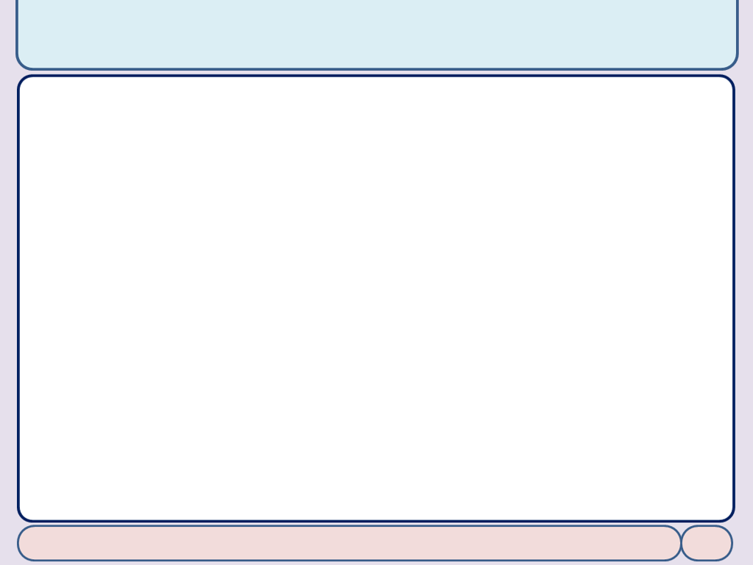
Appendix E: Passing Arguments into Functions
Microprocessors and Assembly Language, Fall 2019, AUT, Tehran, Iran

Slide 4
Passing Arguments
Three ways to pass arguments (parameters) to functions
Through registers
Through memory using references
Using stack
Microprocessors and Assembly Language, Fall 2019, AUT, Tehran, Iran

Slide 5
Passing Arguments
Passing arguments through registers
AREA OUR_PROG, CODE, READONLY MOV R0, #5 ; R0 = 5 MOV R1, #7 ; R1 = 7 BL BIGGER ; BIGGER(5, 7) HERE B HERE ; stay here ; ======================================= ; BIGGER returns the bigger value
; Parameters: R0 and R1: the values to be compared ; Returns: R0: containing the bigger value ; ======================================= BIGGER CMP R0, R1 BHI L1 ; if R0 > R1 go to L1 MOV R0, R1 ; R0 = R1 L1 BX LR ; return END
Microprocessors and Assembly Language, Fall 2019, AUT, Tehran, Iran

Slide 6
Passing Arguments
Passing through memory using references
Store the data in memory and pass its address through a register
ADR R0, OUR_STR ; R0 = addr. of OUR_STR
BL STR_LENGTH ; STR_LENGTH(&OUR_STR)
HERE B HERE ; stay here
OUR_STR DCB "HELLO!"
; =======================================
STR_LENGTH MOV R1, R0 ; move string pointer to R1
MOV R0, #0 ; use R0 as string length counter
L_BEGIN LDRB R2, [R1] ; fetch a character from string
CMP R2, #0
BXEQ LR ; return if character is null (end of string)
ADD R1, R1, #1 ; point to next character in string
ADD R0, R0, #1 ; increment the counter
B L_BEGIN
Microprocessors and Assembly Language, Fall 2019, AUT, Tehran, Iran

Slide 7
Passing Arguments
Passing arguments through stack
The arguments are pushed onto the stack just before calling the function and popped off after returning LDR SP, =(0x40000000+(16*1024)) ; init stack pointer
MOV R0, #5
PUSH {R0} ; push Arg1
MOV R0, #7
PUSH {R0} ; push Arg2
BL BIGGER ; BIGGER(5, 7)
ADD SP, SP, #8 ; adjust the stack pointer to remove the arguments
HERE B HERE ; stay here
; =======================================
BIGGER
LDR R0, [SP, #4] ; R0 = arg1
LDR R1, [SP, #0] ; R1 = arg2
CMP R0, R1
MOVLO R0, R1 ; if R0 < R1 move R1 into R0
L1 BX LR ; return
Microprocessors and Assembly Language, Fall 2019, AUT, Tehran, Iran

Slide 8
Passing Arguments
In ARM CPU, the arguments are passed in the first four registers
If there are four or fewer arguments
If there are more than four arguments
The first four are passed in the first four registers
The rest are passed on the stack
Microprocessors and Assembly Language, Fall 2019, AUT, Tehran, Iran

Slide 9
ARM Application Procedure Call Standard
AAPCS provides a standard for implementing the functions
Some rules
The arguments must be sent through R0 to R3
The return value must be returned in R0 (and R1 for return a 64-bit)
The functions can use R4 to R8, R10 and R11 for temporary storage
Their values must be saved upon entering the function and restored before returning
The stack must be used as Full Descending
Microprocessors and Assembly Language, Fall 2019, AUT, Tehran, Iran

Slide 10
End of Appendix E!
Microprocessors and Assembly Language, Fall 2019, AUT, Tehran, Iran

